Slide 1
Comparing Different Companies’ Performances
Financial and Business Analytics
Victory Njoku (20087432), Muzzamil Aftab (20094751), Dhanush Muthyala (20096058), Mohammed Parvez (20096108)

Slide 2
Introduction
In this report we will be exploring Tesco plc and Loblaw Companies ltd for Executive Board of Directors of Wood’s Plc
Analysis will be performed using manual calculations as well as AI-Generated calculation (Claude AI)
These are both similar companies that operate in the grocery retail industry
Our recommendation at Platinum Consultants plc is that Wood Plc should invest in Tesco Plc

Slide 3
Company Overview
Tesco plc
Tesco Plc is one of the biggest food retailers and largest supermarket chain in the UK
Tesco has supermarket chains, convenience stores, and online shops operating in the United Kingdom, Ireland, and Central Europe
Tesco trades in the London Stock exchange

Slide 4
Company Overview
Loblaw Ltd.
Loblaw Companies Limited is the largest retailer of food and pharmacy products in Canada
Loblaw has a vast network of supermarkets, pharmacies, and retail stores under several popular brands
Loblaw trades in the Toronto Stock Exchange
Loblaw also offers pharmacy services, health care products, fashion clothing, and financial services via PC Financial.

Slide 5
Financial Performance Overview
Tesco Plc
Tesco had a ROCE of 21.12% in
2023, 36.17% in 2024 and 40.47%
in 2025
Tesco had a ROA of 2.17% in
2023, 4.87% and 5.70% in 2025
Tesco had a ROE of 25.30% in
2023, 67.82% in 2024 and 65.90%
in 2025
Key Measures | 2023 (£m) | 2024 (£m) | 2025 (£m)
Revenue | 65,762 | 68,187 | 69,916
Gross Profit | 3,661 | 4,849 | 5,051
Operating Profit | 1525 | 2821 | 2711
Net profit | 744 | 1,192 | 1,630

Slide 6
Financial Performance Overview
Loblaw Ltd.
Loblaw had a ROCE of 12.05% in
2023, 11.93% in 2024 and 17.62% in
2025
Loblaw had a ROA of 6.98% in
2023, 6.83% and 9.45% in 2025
Loblaw had a ROE of 25.69% in
2023, 25.50% in 2024 and 33.85%
in 2025
Key Measures | 2023 (C$m) | 2024 (C$m) | 2025 (C$m)
Revenue | 58,345 | 60,123 | 63,903
Gross profit | 18,083 | 18,835 | 20,032
Operating Profit | 3704 | 3474 | 4424
Net Profit | 2187 | 2275 | 2738

Slide 7
Profitability
Ratio | Tesco | Loblaw | Better
Gross Profit Margin | 5.57% → 7.22% | 30.99% → 31.35% | Loblaw
Net Profit Margin | 1.52% → 3.17% | 4.97% → 5.76% | Loblaw
Return on Assets | 8.18% → 18.99% | 6.98% → 9.45% | Tesco
ROCE | 21.12% → 40.47% | 12.05% → 17.62% | Tesco

Slide 8
Profitability and Ratio Analysis
Tesco & Loblaw
Tesco profitability generally increased consecutively from 2023 to 2025
Gross profit margin went from 5.57% in 2023 to 7.11% in 2024 and then 7.22% in 2025. Additionally, sales-to-assets and return on assets also demonstrated similar increases.
Loblaw’s gearing ratio was 36.44% in 2023 but increased in 2024 to 40.19% which is risky for Loblaw because it highlights that the company was geared on long-term debt as a source of finance other than share capital or equity.

Slide 9
Liquidity, Efficiency & Financial Risk
Tesco & Loblaw
The year 2025 has proven to be a difficult year for Loblaw in its ability to pay its bills on time. Ratios such as Current ratio, quick ratio and dividend cover prove this.
Loblaw’s gearing ratio was 36.44% in 2023 but increased in 2024 to 40.19% which is risky for Loblaw because it highlights that the company was geared on long-term debt as a source of finance other than share capital or equity.
Tesco averagely held its product in inventory 14.8 days in 2023, 15.3 days in 2024 and 15.7 days in 2025. Which is very much lower than Loblaw’s from 2023 through 2025.

Slide 10
Liquidity & Financial Risk
Ratio | Tesco | Loblaw | Winner
Current Ratio | 2.54 → 1.78 | 1.25 → 1.08 | Tesco
Quick Ratio | 2.04 → 1.23 | 0.72 → 0.61 | Tesco
Gearing | 30–33% | 34–40% | Tesco
Interest Cover | 2.5 → 3.6 | 4.6 → 6.0 | Loblaw

Slide 11
Liquidity & Financial Risk
Investment Interpretation
Liquidity ratios show whether a company can meet its short-term obligations, while solvency ratios measure long-term financial risk.
Investors generally prefer companies with strong liquidity and manageable debt because they are financially more stable.
Tesco had stronger liquidity.
Lower gearing means lower financial risk.
Loblaw had better interest cover.
Overall, Tesco offers a stronger financial position.

Slide 12
Operational Efficiency
Tesco and Loblaw
Ratio | Tesco | Loblaw | Winner
Inventory Days | 15 | 53–56 | Tesco
Inventory Turnover | 24.7 → 23.2 | 7.0 → 6.8 | Tesco
Receivable Days | 7 | 11–13 | Tesco

Slide 13
AI Analysis & Validation
Tesco plc
Claude AI thoroughly analyzed all ratios but some if it analysis were not validated by us at Platinum Consultants plc
Its analysis on Tesco’s net profit margin is that it Improved steadily from 1.1% to 1.7% to 2.3%. FY2023 net margin was heavily depressed by a large net impairment charge on property/leases/goodwill (c.£1bn) taken through operating profit; with no equivalent one-off in FY2024/FY2025, margin recovered. FY2025 also benefits from lower net finance costs and a smaller drag from discontinued operations (only £26m loss vs £572m loss in FY2024, when the Banking disposal completed).
Our validation is that Claude AI used profit attributable to owners / revenue for its net profit margins for Tesco, however the formula for our manual calculation was net profit before tax/sales. Our calculations are different from Claude AI for all three years. Claude AI calculation is not validated for this analysis.

Slide 14
Market and Share Price Analysis
Tesco and Loblaw
Investor confidence has improved in both companies for the years between 2023 and 2025 based on market performance.
Stock price of Tesco was approximately 250 pence in early 2023 and has increased to approximately 490 pence by mid-2025.
Loblaw's share price increased from approximately CAD 29 to CAD 66.
Tesco's share price 489.50 pence was higher than its 50-day moving average, which was equal to 456.48 pence.
Loblaw's share price CAD 65.81 also traded above the 50-day moving average CAD 61.51

Slide 15
Market Performance
Tesco and Loblaw
Indicator | Tesco | Loblaw | Winner
Share Price Trend | Strong | Strong | Loblaw
50-Day Moving Average | Above MA | Above MA | Tie
Reuters News | Market share gains, upgraded forecast | Expansion & profit growth | Tesco

Slide 16
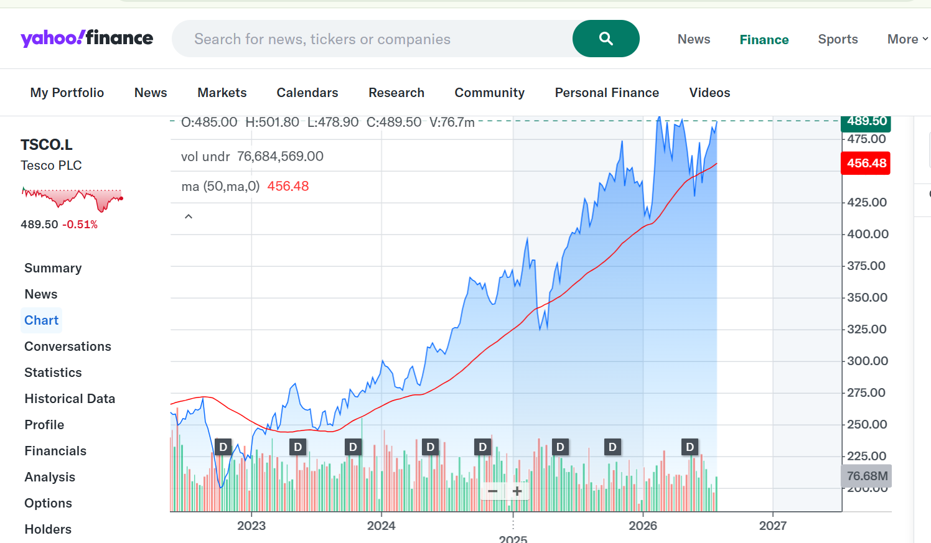
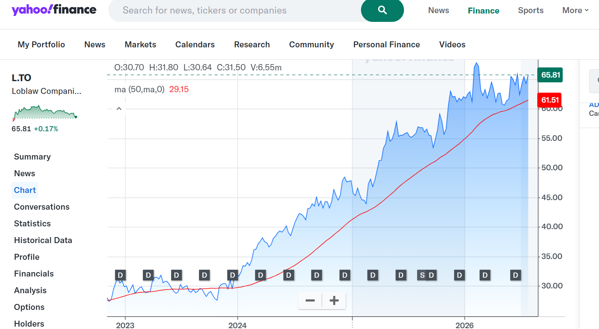
Charts
Share Price Trend

Slide 17
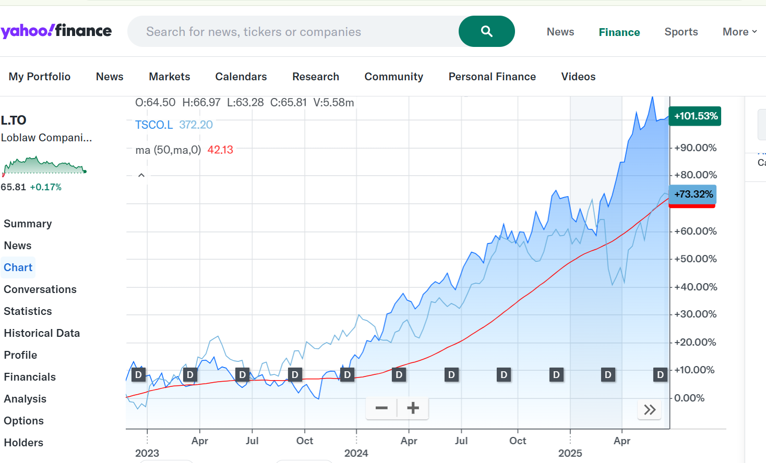
Charts
Comparative share price trend

Slide 18
Future Prospects
Tesco & Loblaw
Tesco is currently exploring plans on selling its central and eastern European operations due to market pressure from its competitors.
Tesco shareholders would not be affected by this because bringing the business back home has proven to have a positive effect on the share price which has doubled in the past five years.
Successes in Loblaw’s branded company’s have resulted in its quarterly dividend to be increased from 10 percent to 15.5 percent per common share
These successes has further motivated Loblaw in its plan to invest C$ 2.4bn into setting up 70 news stores across Canada.

Slide 19
Investment Recommendation
  Tesco plc
Tesco plc is recommended for investment. This recommendation is mainly based on the ongoing financial improvements made by Tesco.
The gross profit margin increased from 5.57% in 2023 to 7.22% in 2025, and Return on Assets increased from 2.17% to 5.70%.
This decision is also supported by the market analysis. The share price of Tesco increased from about 250 pence in early 2023 to 490 pence
In mid-2025, with Tesco's share price of 489.50 pence always being higher than its 50-day moving average, which was equal to 456.48 pence.
This decision was made on the basis of future value rather than existing margins

Slide 20
Final Investment Decision
Category | Winner
Profitability Improvement | Tesco
Profit Margins | Loblaw
Efficiency | Tesco
Liquidity | Tesco
Financial Risk | Tesco
Market Performance | Tesco
Future Growth | Tesco

